Slide 1
Set 2 Nonsense Words

Slide 2
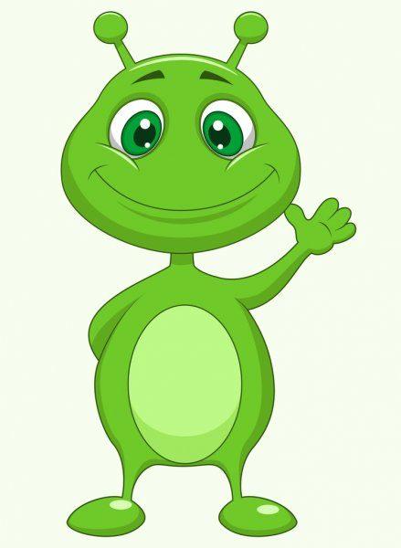
tay

Slide 3
shay

Slide 4
kay

Slide 5
vray

Slide 6
chay

Slide 7
blay

Slide 8
steen

Slide 9
sclee

Slide 10
treek

Slide 11
cheeth

Slide 12
fleep

Slide 13
dreen

Slide 14
quigh

Slide 15
zigh

Slide 16
kigh

Slide 17
glight

Slide 18
dight

Slide 19
pright

Slide 20
sprow

Slide 21
zow

Slide 22
trow

Slide 23
drow

Slide 24
spow

Slide 25
nellow

Slide 26
moom

Slide 27
goove

Slide 28
choove

Slide 29
shoom

Slide 30
drood

Slide 31
sploot

Slide 32
nipstood

Slide 33
swook

Slide 34
thook

Slide 35
jaygood

Slide 36
plook

Slide 37
snookbay

Slide 38
charp

Slide 39
stard

Slide 40
plarp

Slide 41
blart

Slide 42
flarg

Slide 43
nart

Slide 44
forg

Slide 45
sporg

Slide 46
sorm

Slide 47
morch

Slide 48
thorch

Slide 49
sair

Slide 50
nair

Slide 51
gair

Slide 52
yair

Slide 53
zair

Slide 54
plair

Slide 55
wirp

Slide 56
nirth

Slide 57
quirp

Slide 58
firl

Slide 59
mirch

Slide 60
yirp

Slide 61
doud

Slide 62
hout

Slide 63
plout

Slide 64
frout

Slide 65
bround

Slide 66
yound

Slide 67
skoy

Slide 68
bloy

Slide 69
spoy

Slide 70
joyal

Slide 71
foy

Slide 72
stoy

