Slide 1
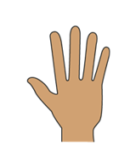
Mastering Number at Home
Year 2
Notes:
The first ten minutes of the workshop are for parents only. It is to set the scene and offer the rationale for engaging with them in their children’s learning.
The first seven slides are designed for use with parents only. Their children should join them for the subitising activity on slide 10.
Most of the home learning resources will be introduced and ‘tried out’ in the live session with parents. So that you can do this, please have the following printed off/ready for use in the workshop:

Slide 2
Children and adults will work through the session materials, guided by the class teacher.
These will cover:
Year 2
5 and a bit using 10-frames and dice frames
Shows 7/Does NOT show 7
‘Ways to make 10’ and ‘How many more make 10?’
Make 10 Bingo
Odd and even numbers on a 10-frame
Writing and categorising expressions for 7 and 8
Notes:
Hidden slide - teacher info only

Slide 3
Aims of the session
Share with you some of the things your child will be learning in school
Improve your confidence in helping your child with maths
Create some games and activities for use at home
Share with you the home learning activities

Slide 4
Why engage you in your child’s learning?
Research evidence suggests that when parents are engaged in their children’s learning, outcomes for children can be improved.
The research also highlights the fact that parents feel they need more support to understand the current curriculum content and how they can support their child with their learning at home.
Desforges, C. and Abouchaar, A. (2003); Goodall, J. and Vorhaus, J. (2011);
The Education Endowment Foundation (2019); Sarjeant, S. (2021)
Notes:
Research proves that high quality teaching in school is key to raising attainment. As a supportive measure, if parents are taught about how to engage in their children’s learning at home, this can have a dramatic impact on outcomes, even in schools that are successful.

Slide 5
BBC News Report 2006
69% of parents do not help children with their homework because…
Everything has changed since they were at school and they are not confident in the new methods.
BBC News Report 2010
82% of parents feel unable to help pupils with their homework.
Notes:
Why? Time, child to do unaided, confidence.
Most felt lacked confidence because everything has changed since they were at school. Some said they didn’t want to help in case they got the methods wrong. This was particularly true in maths.
Initiatives introduced, like ‘Keeping up with the children,’ ‘Inspire workshops’ and employing parental engagement coordinators in some schools.
Due to lack of confidence.

Slide 6
The ‘problem’ with maths
“My dad thinks that the way he does maths is easier and better than my way but he doesn’t understand my way and his way confuses me.”
Pupil – Catford High School
That’s not the way we do it in school!
Notes:
In the Impact in Learning maths programme, children regularly talked about the clash between the maths learnt in school and what parents were showing them at home.
Parents regularly heard the saying ‘that’s not the way we do it in school!’ when they offered to support maths homework, relying on what they were taught.

Slide 7
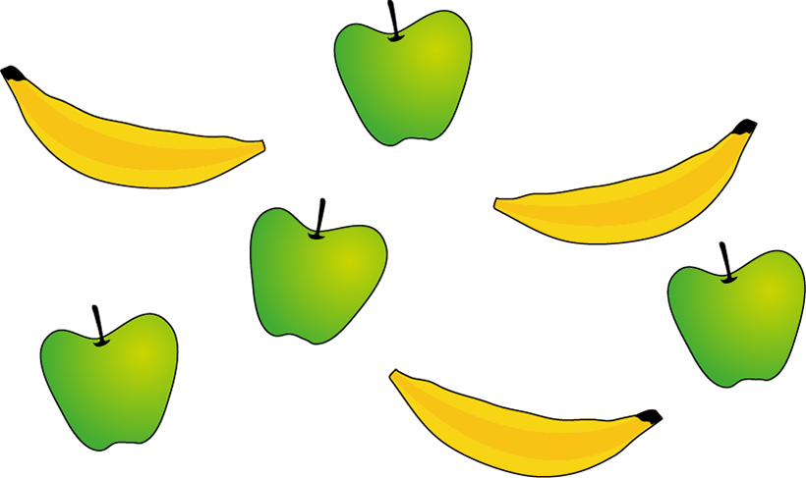



How does Mastering Number help us to teach maths in school?
The Mastering Number Programme in Year 2 will help your child to develop good number sense.
Some of the things they are learning include:
Know different ways to ‘make’ (compose) a number
Recognising small numbers of objects without having to count them
Notes:
The MN Programme is a new national programme based on research into what is important in early maths education.
Share our maths in school.
‘Number sense’ includes lots of things; the things mentioned here are some of them, but we are only going to focus in this session on the second two.
It is worth mentioning to parents here that the numbers children use may be smaller than what they can do at home, but we are purposefully focusing on smaller numbers so that the children can develop a deep understanding of numbers to develop that good number sense.
Children will be learning gradually to count out larger sets of objects and join in with the counting numbers, but to have a really good foundation to build on, the smaller numbers are so important.

Slide 8
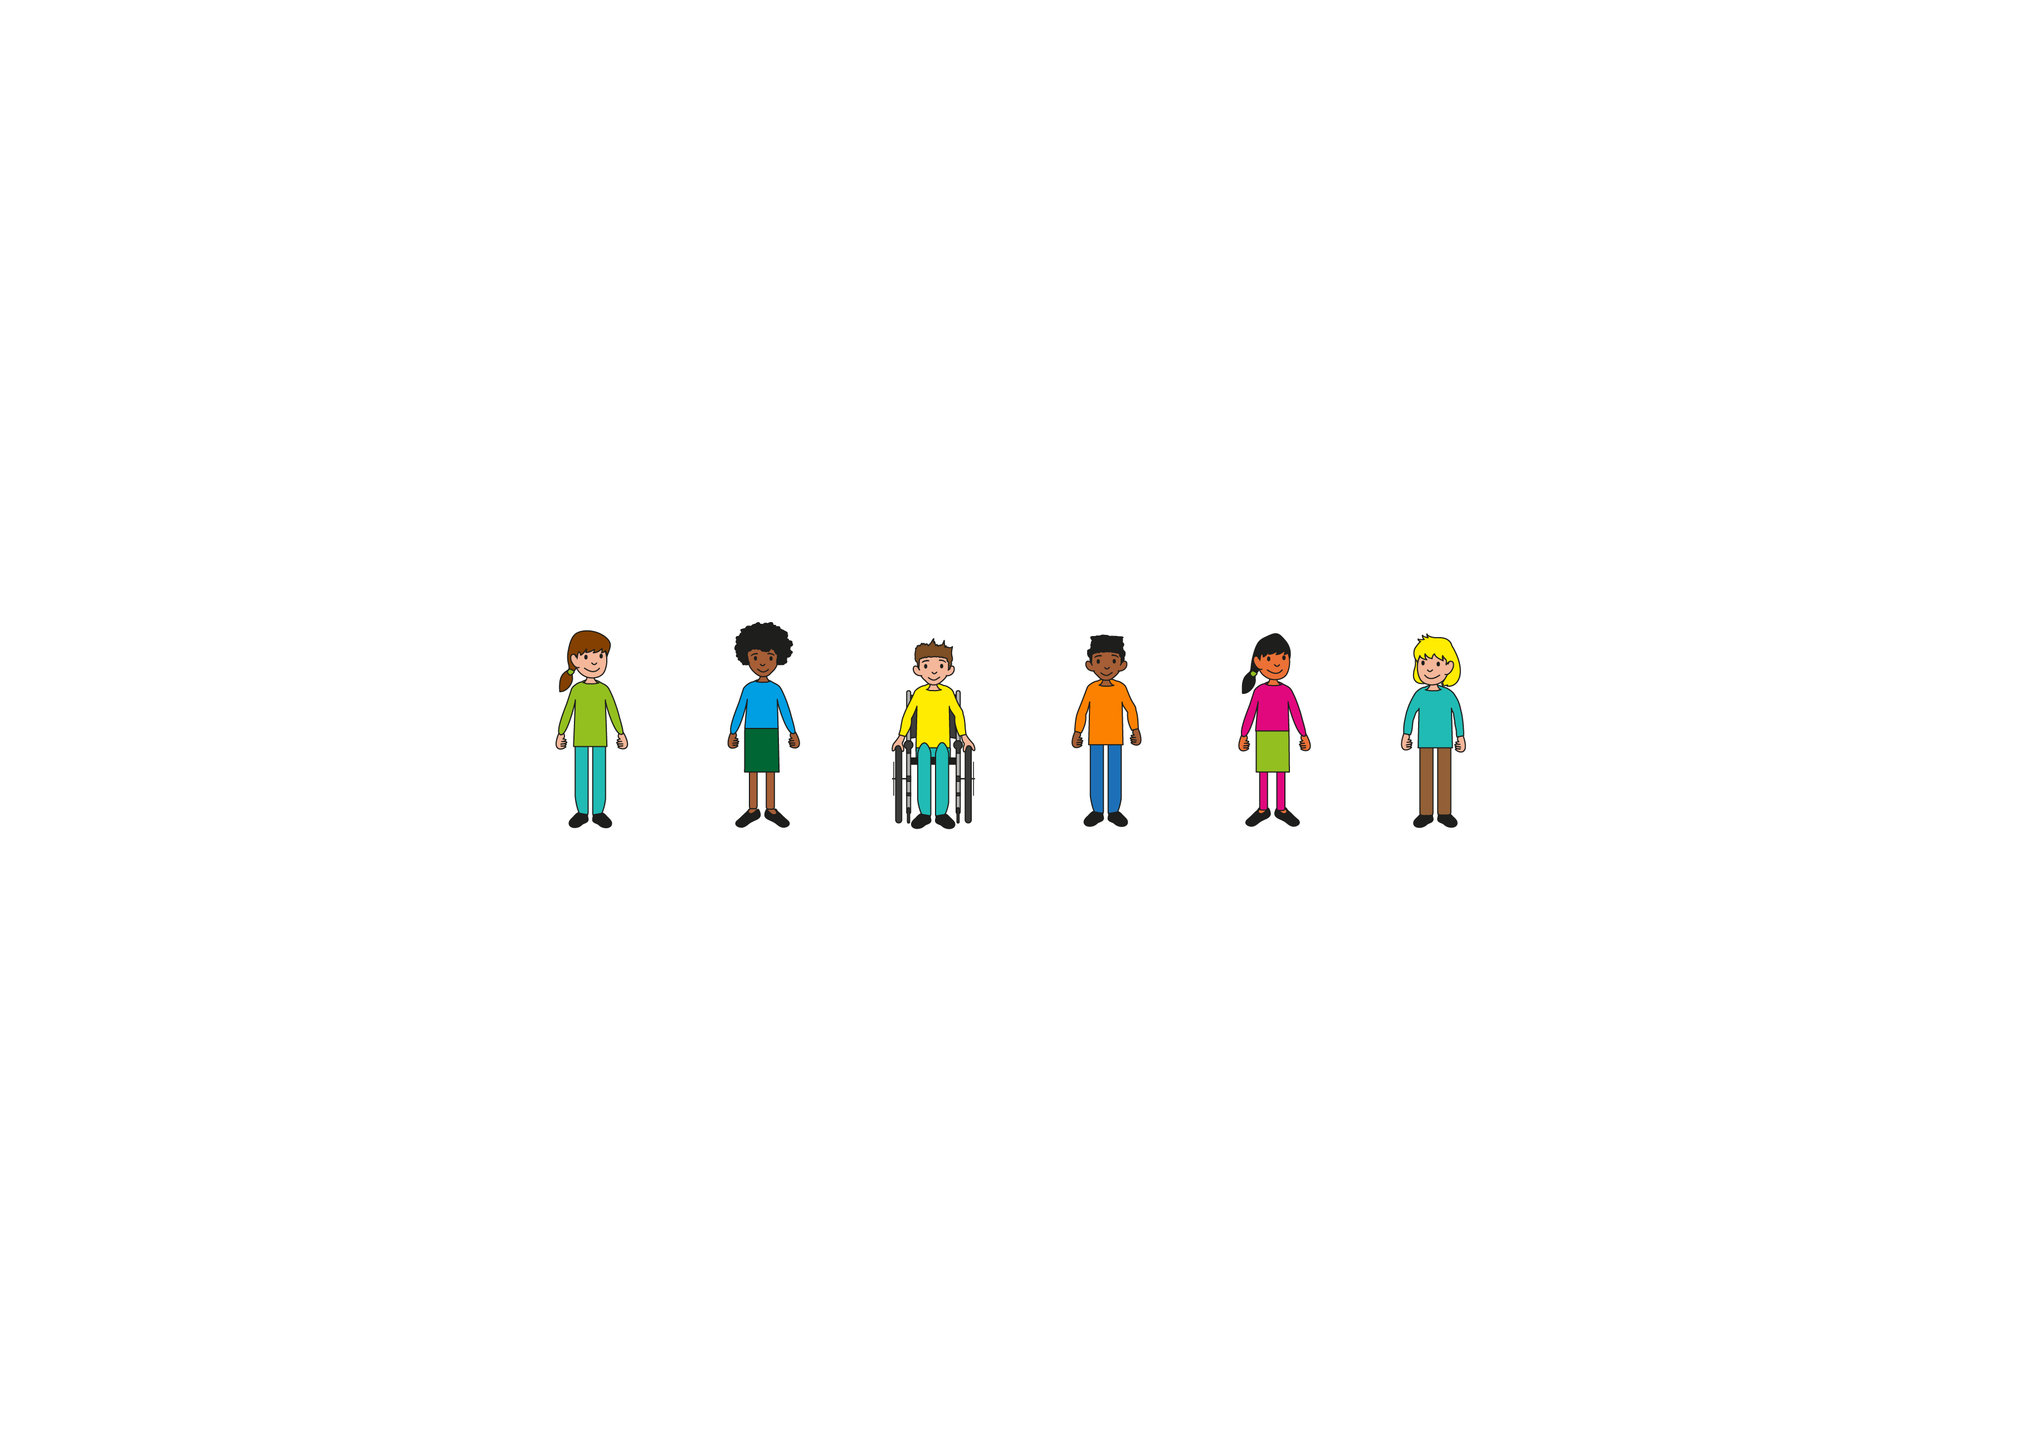
How does knowing how numbers are ‘made’ help children?
I know that 8 is made of 5 and 3 so I will also know...
8 – 3 = 5
80 – 30 = 50
5 + 3 = 8
50 + 30 = 80
0.5 + 0.3 = 0.8
500 + 300 = 800
0.8 – 0.3 = 0.5
Notes:
Teachers can point out that the deeper understanding helps children in their learning later on in school. The example should be shared with parents.
Children who develop good number sense in Early Years and Key Stage one are much more confident and capable in maths later on.

Slide 9
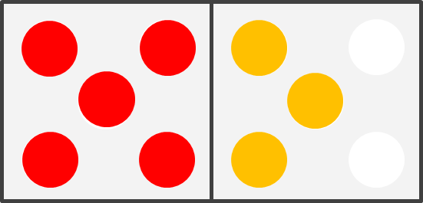
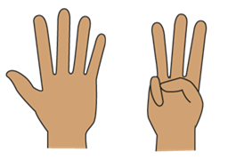
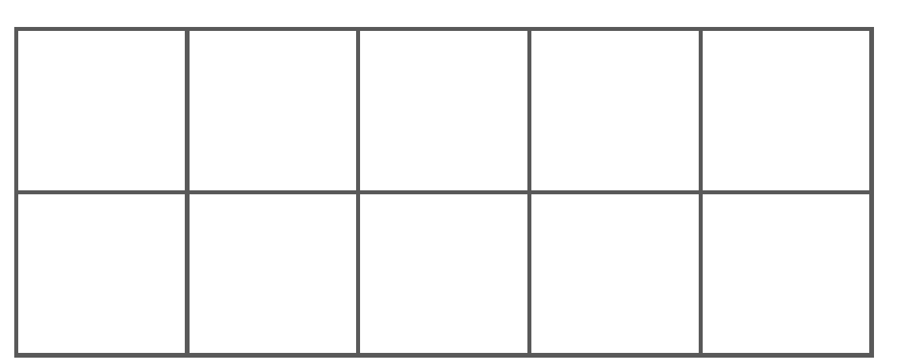
Looking at the numbers 6, 7, 8 and 9
Children will learn that these numbers all have 5 ‘inside them’, as well as seeing all the ways they can be made.
I know that 8 is made of 5 and 3.
Notes:
Explain the 5 and a bit strategy. We always start with 5. We then consider the ‘bit’ that has been added on to 5 to make a larger number. 6 is a little bit and 9 is a big bit.
This helps children to see the relationships between the numbers and how they link to both 5 and 10 (using the gaps to bridge to 10).

Slide 10

Prepare the matching activity by cutting out the cards
Week 1
Notes:
Ask adults to cut out the cards whilst the children are being brought in.

Slide 11
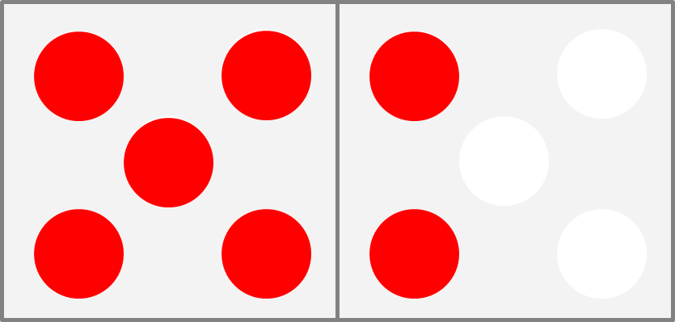
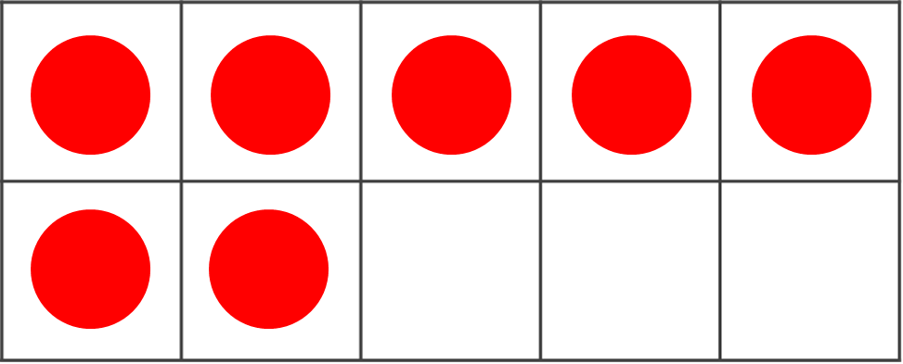
Play ‘Copy my number’
Grown-ups: place 7 counters on the dice frame as shown.
Children: can you make the same number on the 10 frame showing it as ‘5 and a bit’?
_____ is made of 5 and _____.
5 and ____ make _____.
Week 1
Notes:
Copy my number – grown-up completes on dice frame and child replicates it on 10 frame.
Remind the grown-ups that they need to place the 5 first, then add the other counters.
Remind children to begin with 5 and look carefully at the second part. Can you see the two on the dice frame? Where is the two on the 10 frame? What is the same? What is different (variation).
In the class-based teaching materials, the comparison is made (using 5 and a bit) between the Rekenrek and the ten-frame. This highlights the importance of seeing the different representations of 7.
Can your child do it when you hide the dice frame after showing them once? ‘Close your eyes and visualise what you saw…’
Now try again for 8 and 9.

Slide 12
Play ‘Shows 7 / Does not show 7’
Sort the cards:
Shows 7 | Does NOT show 7
Week 1
Notes:
Use the dice frame cards from your pack to discuss and sort the cards as to whether they show 7 or not. You might play a game with your child, taking it in turns to decide and place the cards.
When they are all placed, look at the cards that do NOT show 7. Ask your child – why do these cards NOT show 7? Allow them to reason:
7 is made of 5 and 2 and this card only has 5 and 1.
Reiterate that we don’t just want children to say, ‘because it is 6.’
Research show that if they can reason about when an amount is not a given number, they are more able to reason about when it is.

Slide 13
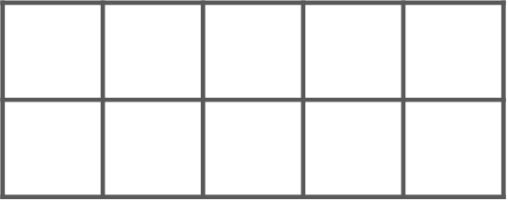
Play ‘Match my fingers’
Grown-ups: use your fingers to show a number between 5 and 9.
Children: can you find four cards that show the same number?
Week 1: ‘Other things to try at home’
Notes:
This time the child has all of the cards. Grown-up shows 5 and a bit on fingers. MAKE SURE THAT ONE HAND IS SHOWING 5.
Can your child find all four cards to match your number?
The children might use the fingers that are down to look for the ‘spaces’ on the cards – connects to both 5 and 10.
Knowing that the numbers are a bit more than 5 and a bit less than 10 means that we think of the numbers relationally.
8 is made of 5 and 3. It is also 2 less than 10.

Slide 14
Play ‘Ways to make 10’
You will need your 10 frame and 10 counters.
Week 2
Notes:
It is important that children are aware of all of the numbers that are parts of 10.

Slide 15
Start at the bottom and place two at a time.
Children: Place the counters on the 10-frame so they are all red.

Slide 16
Grown-ups: turn one counter over at a time.
Say the stem sentence together.
10 is made of ____ and ____.
____ and ____ make 10.

Slide 17
Keep saying the stem sentence together.
10 is made of ____ and ____.
____ and ____ make 10.

Slide 18
Continue doing this until all the counters are yellow.
10 is made of ____ and ____.
____ and ____ make 10.
Notes:
Explain to the parents that working in a systematic way like this helps children to see the relationship between the numbers and to explore all the possible ways to make 10.

Slide 19
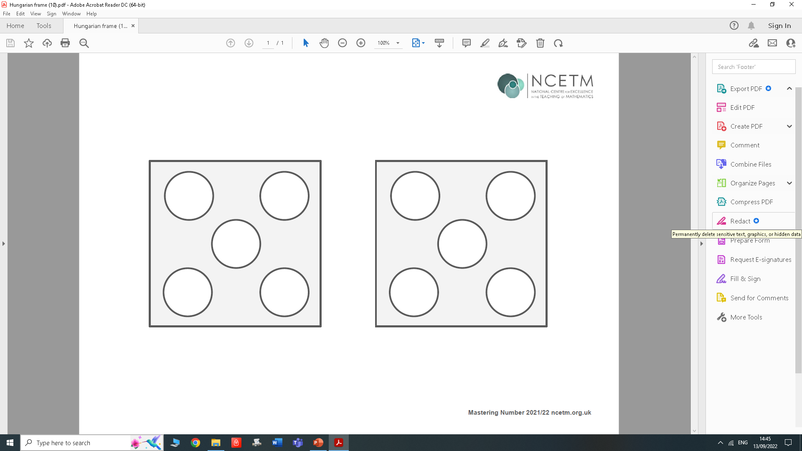
Play ‘How many more to make 10?’
Now you will need your dice frame and 10 counters.
Week 2

Slide 20
Grown-ups: Place 7 red counters onto the dice frame, using the ‘5 and a bit’ pattern.
Children: Fill the spaces with yellow counters and use the stem sentence.
10 is made of _____ and _____.
_____ and _____ make 10.
Notes:
Dice frame:
Grown up puts 7 red in ‘5 and a bit pattern.’
Remind parents that this allows children to start from having 5 already in place.
Children fill up dice frame with yellow counters.
Child uses the stem sentence to say what they see: 10 is made of 7 and 3.

Slide 21
Grown-ups: Repeat using a different ‘5 and a bit’ number (e.g. 6, 8 or 9).
10 is made of _____ and _____.
_____ and _____ make 10.
In Week 3, children will be asked to say how many are needed to make 10 without filling the spaces.
Notes:
Dice frame:
Grown-up puts 8 red in ‘5 and a bit pattern’. Children fill up dice frame with yellow counters.
Child uses the stem sentence and says: 10 is made of 8 and 2.
In Week 3, parents could make this harder by making the arrangements less obvious, e.g. so there are empty spaces on both sides of the dice frame.

Slide 22
You could play the same game using the 10-frame – this might be more tricky!
10 is made of _____ and _____.
_____ and _____ make 10.
Week 2
Notes:
Remind grown-ups that we are still using the 5 and a bit strategy, so the top row should always be 5 reds.
NOTE: The home learning for this in Week 2 suggests that children should use the 10-frame for this activity. If parents feel that the dice frame is easier, they can use this instead.

Slide 23
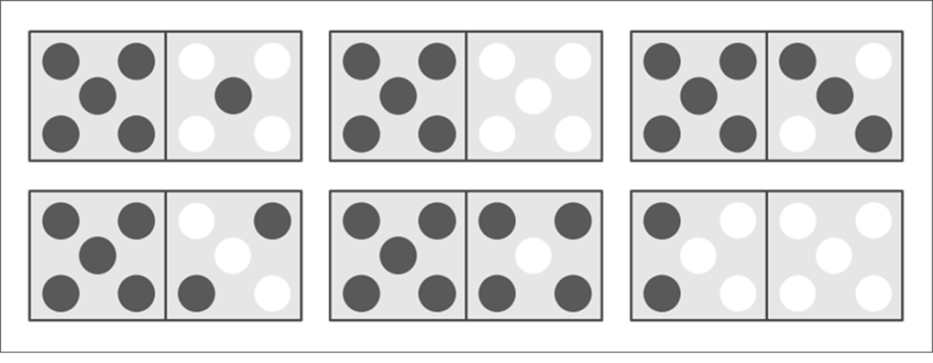
Introducing ‘Make it 10 Bingo’
Player 1: pick a caller card and read it out
Player 2: find the number that makes 10 and cover it with a counter.
What does 4 need to make 10?
Week 3
Notes:
Simply model activity rather than doing it in the session
When all the numbers are covered with counters, that person is the winner and the game is over.
Swap cards and play again.

Slide 24

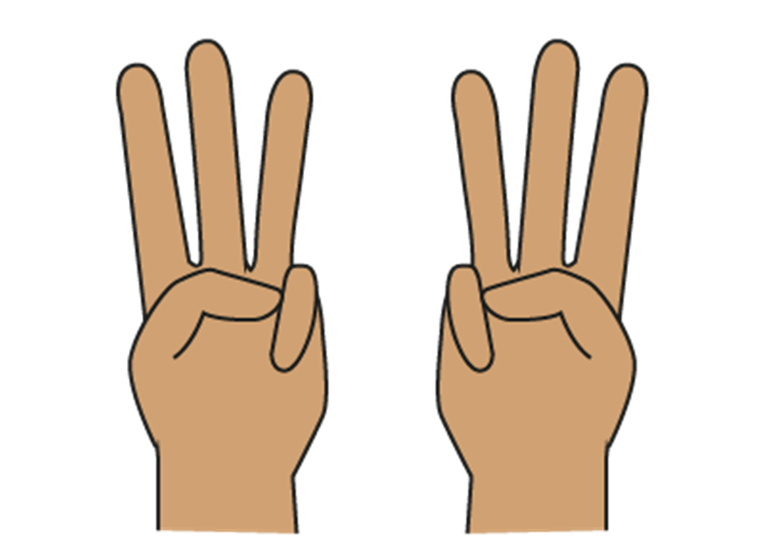
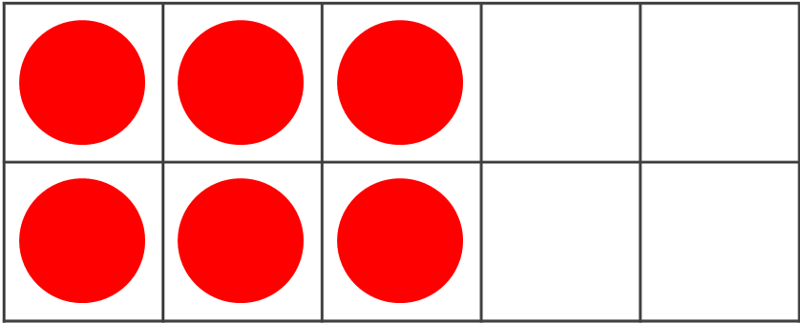


Odd and even numbers ‘inside’ other numbers
Let’s think about the odd and even parts of numbers.
Week 4
Notes:
We want children to understand that even numbers can be made of 2s, and can be made with 2 equal parts, i.e. doubles.
Grown-ups can help children to recognise that even numbers can be composed from 2 odd parts or 2 even parts.
Knowing this will help them reason about calculations involving odd and even numbers.
These are some of the images that we use in class at home, you will use 10-frames to make odd and even patterns.

Slide 25
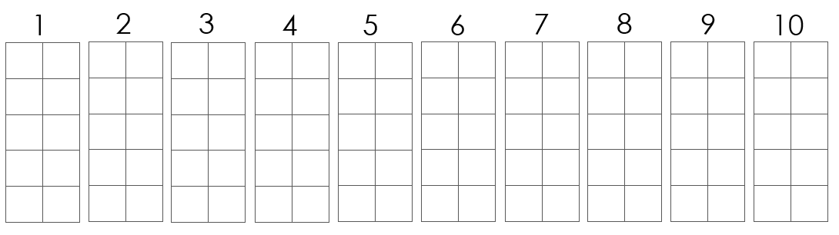
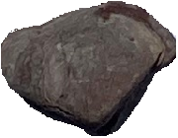
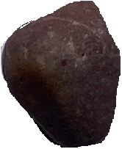
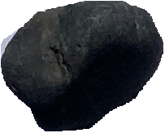
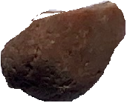
Use your objects to show the numbers on the 10-frames.
Place them in the order shown.
What do you notice about the pattern that is being made by 4 or 5 objects?
Week 4
Notes:
The grown-ups and children should use objects provided to complete the numbers on the board. The objects used will need to be small enough to fit into the squares on the sheet when it is enlarged to A3.
Bear in mind that, to complete the sheet, children will need 55 objects – you might not need to complete the full sheet, as this will be completed as part of the homework programme.
The number above each 10-frame shows you how many objects you need to place on that 10-frame.
Give your child a number between 1 and 10. Ask them to place objects, 2 at a time, into the columns of that number’s 10-frame.
For example, let’s start with number 4. Your child should gather four objects and place them in row of two starting at the bottom.
Click twice to show pebbles on number 4. Allow time for children to copy this on their board.
Ask your child, “Do they (the objects) all have partners?” Put their fingers on two at a time from the bottom going up – there’s a pair… there’s a pair..
Because 4 is an even number, they all have pairs. You can see the shape of four has ‘flat top’ in the 10-frame.
Now try the same with 7. Start at the bottom and put them on in twos. What do you notice?
If one is left over, the number is odd. (Link this to having an odd sock at home).
So 7 is an odd number. “Can you see the odd one that gives 7 an odd top?
Leaving those on your board, choose other numbers. Can your child predict whether they will be odd or even?
Can children also notice that the spaces left in each 10-frame are also odd (if the number of objects is odd) or even (if the number of objects is even)?
When complete, the teacher should get grown-ups and children to chant – ‘one is odd, two is even, three is odd…’ and so on.
You may draw attention to the pattern that is made by highlighting the even blocks and odd tops. The reason it has a flat top is because it is made of twos. The odd top only has one at the top (when they are put in two columns).
At home, parents can use small items like dried kidney beans, dried lentils, or buttons – whatever they have available.

Slide 26
Play ‘Drop 10 counters’
How many of each colour? Are the parts odd or even?
You will need 10 double-sided counters to play.
Week 4
Notes:
Try to subitise – but it might be tricky depending how they land!
Maybe one part can be subitised, and children can try and remember the other parts – they may need to check by counting!
This will help children practise remembering the ways to make 10, but add in the challenge of identifying whether the parts are odd or even.

Slide 27
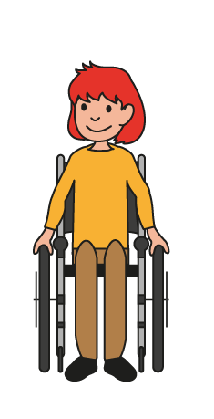
Play ‘Ways of making 7 and 8’
Can you see if 7 can be made of odd or even parts?
6 + 1
5 + 2
4 + 3
3 + 4
2 + 5
1 + 6
Week 5
Notes:
Teacher: Guide grown-ups to use representations to work systematically to model each example. They must place the counters in two columns as shown, just like we did with the objects in the previous task. Start at the bottom and work up placing two at a time.
Look carefully at the parts we have made to show 7. Here we can see 6 and 1. Explain how to write this as an expression. Colours have been used to identify whether the parts are odd or even.
The children should record the expressions on the list sheet provided. Record carefully and accurately.
Bring focus here to the commutative relationship in addition. We want children to record both ways so they recognise the ways to make 7 however they are presented.
Because 7 is an odd number, all the ways of making 7 contain an odd number. Is this the same for all odd numbers?

Slide 28
Can you see if 8 can be made of odd or even parts?
7 + 1
Week 5
Notes:
Do same for 8. Ensure the counters are lined up in two columns as shown. Again focus on commutativity to ensure all possible ways to make 8 are recorded both ways. Why does 4+4 only appear once?
What do you notice about the parts that make 8? They can be odd and odd or even and even. They can’t be odd and even.
We are prompting a generalisation here.
Explain that the same task will be repeated in the home learning for 9 and 10.

Slide 29
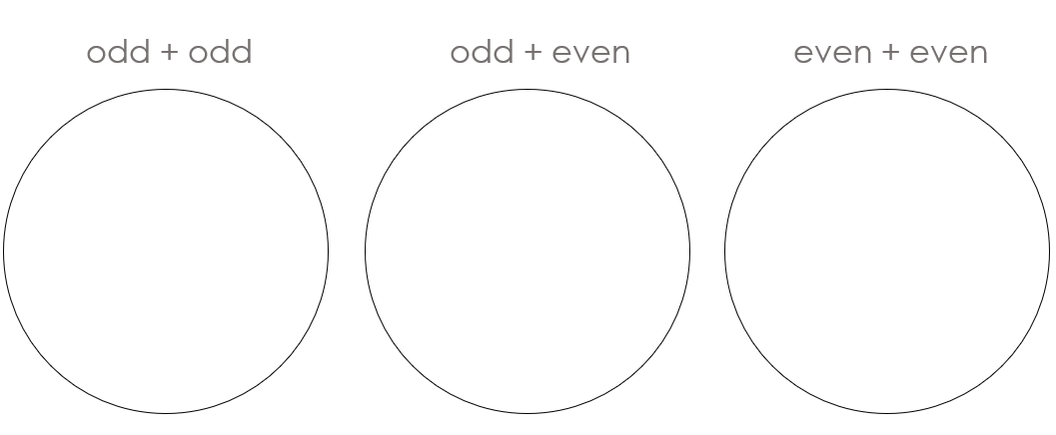
Introducing ‘Sorting expressions’
Week 5
Notes:
Explain to grown-ups that in the home learning session in Week 5, they are to replicate this activity and then cut out and sort the expressions as to whether the parts of the target number are odd and odd, odd and even, or even and even.

Slide 30
Home Learning
You are going to take all the games we made today home with you to practise.
The home learning for this week is set out on a sheet with instructions. You will receive a new sheet and some new activities each week.
Notes:
We anticipate each day that you will do ten minutes of activity. Sometimes it may not take 10 minutes which is fine – maybe you could try some of the additional activities on those days.

Slide 31
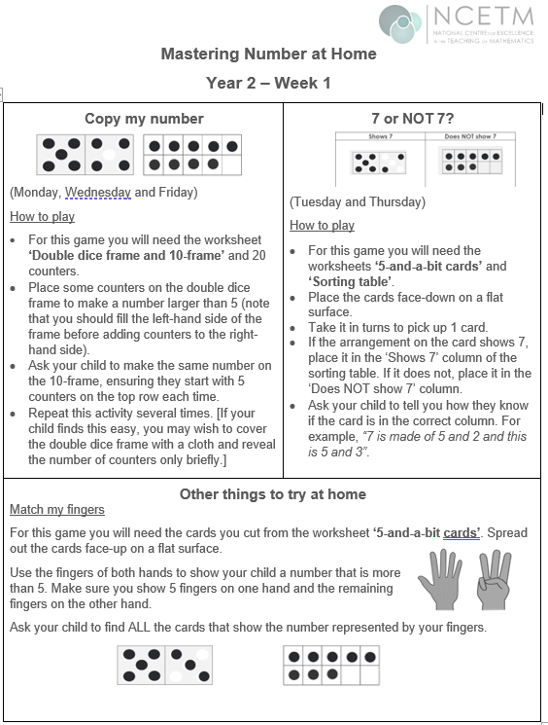
Notes:
Ensure parents have the first sheet in the pack on the day of the workshop so the grown-ups and children can see the layout and ask any questions.
1st Click: Shows the activity we did where we show 5 and a bit on both the dice frame and on the ten frame.
The instructions are there to remind grown-ups of how to carry out the activity.
The home learning sheet and diary asks you to use this activity on Monday, Wednesday and Friday. Try to keep to this if possible, but if you have to move days around due to other commitments, that is fine.
2nd Click: This shows 7 or NOT 7 activity that we did in the workshop. At home, you will be asked to place these on the sorting table to show the numbers that are 7 and those that are not 7.
The sheet asks you to play this on Tuesday and Friday.
3rd Click: This section shows some other things that you might like to try at home. It is not essential to do all of these, but they will support your child in their learning if you can fit any of them in.
Where possible, we would like families to stick to the order of the homework exercises. The additional activities are optional. The might be attempted on the same day, or at the weekend, depending on time.
Some children have clubs during the week and will miss the home learning. We ask them to try to fit a 10 minute session in at the weekend instead.

Slide 32
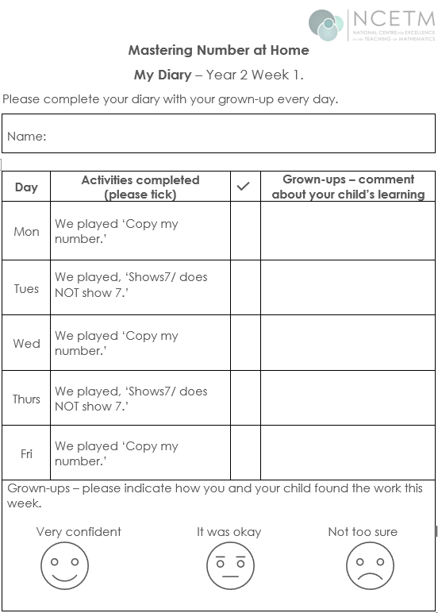
Joe was able to copy all the numbers I showed.
√
Notes:
Class teachers – please ensure the parents have the homework diary in the pack at the workshop so they can easily follow the instructions and can ask any questions.
If your homework is not sent out on a Friday, that is fine – the families should start the diary on the day when they receive the homework and should return it on the same day the following week.
We are asking the grown-ups to play the games on the days indicated on the sheet, although there is flexibility on this and some could be done at the weekend. Emphasise that we do not want them to spend more than 10 minutes each day on this. It can also be shared by family members and doesn’t have to be done with the person who attends the workshop.
Click 1: It would be helpful if the grown-ups made a comment each day to show how well their child attempted the work, any success stories and what the grown-up is ‘noticing’ about the child’s learning.
Click 2: Ask the grown-up to circle the most appropriate face at the bottom to show how confident they and their child felt about this week’s work.
The home learning should be sent out in the usual way for your class. The diary should be completed from whatever day the diary is sent out (i.e. if home learning is sent out on Wednesdays, the children should complete the Wednesday task that night on their diary and the parent should work in order from there). Please request parents to ensure the diary is returned the following week so that a new one and new activities can be issued.
There is no need to ‘mark’ the diary and return it with comments (unless you really want to!) It would be good to note where children are not completing the tasks, not returning the diary, or indicating that they are not confident so that you might make some suggestions for adaptations, where necessary.

Slide 33
References
Axford, N., Berry, V., Lloyd, J., Moore, D., Rogers, M., Hurst, A., Blockley, K., Durkin,H. and Minton, J. (2019) How Can Schools Support Parents’ Engagement in their Children’s Learning? Evidence from Research and Practice. London: Education Endowment Foundation.
Desforges, C. & Abouchaar, A. (2003), The impact of parental involvement, parental support and family education on pupil achievement and adjustment: A literature review. London: Department for Education and Skills.
Goodall, J & Vorhaus, J (2011), Review of Best Practice in Parental Engagement. Department for Education.
Sarjeant, S (2021) Engaging parents in children’s literacy: an investigation into the Impact in Writing programme as a strategy for parental engagement. Available at: https://orca.cardiff.ac.uk/id/eprint/136692/3/1576474%20Suzanne%20Sarjeant%20-%20Final%20thesis%20(002).pdf (Accessed 03.10.2022)

Slide 34
Thank you

