Slide 1

Wellbeing Ambassador Programme
With Brian and Leanne

Slide 2
Week 1
5 ways to wellbeing (continued)

Slide 3
Gimme 5 Game!

Slide 4

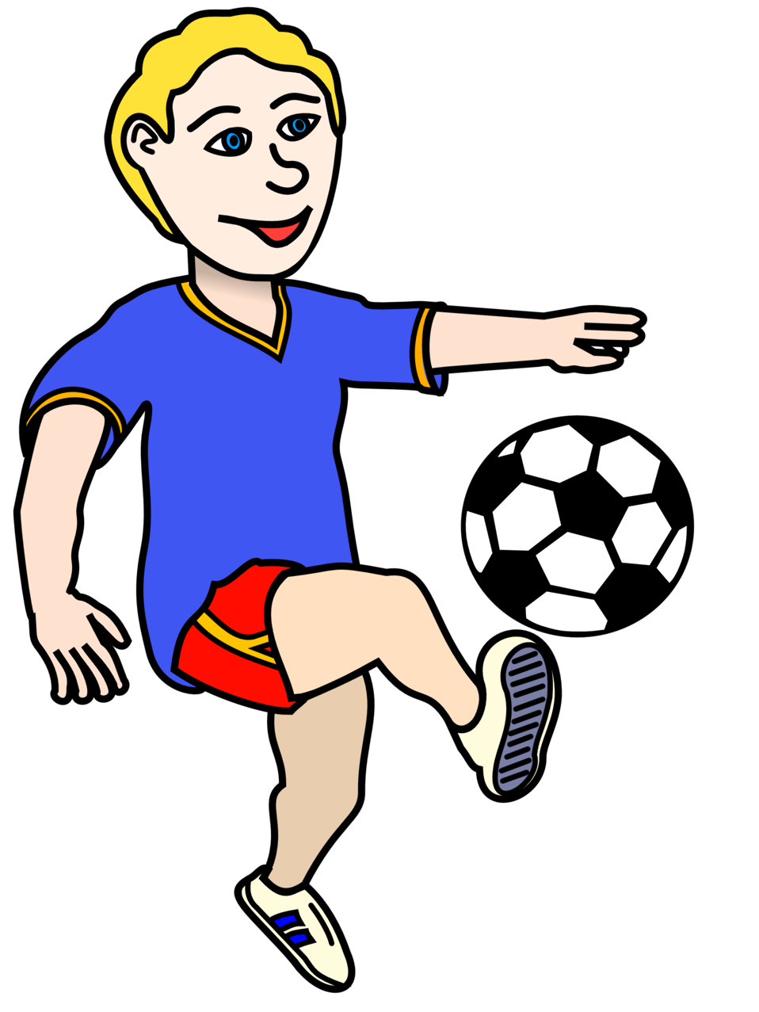

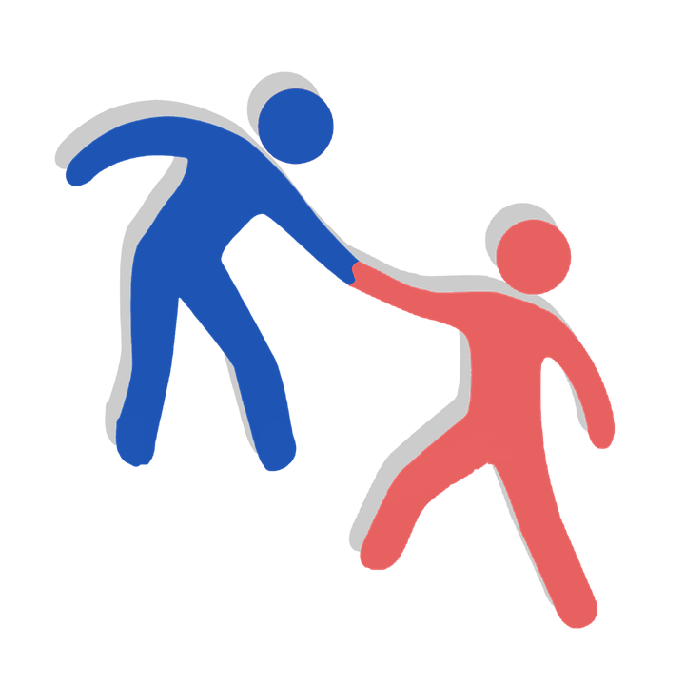

Connect
Be active
Learn
Give
Take Notice
5 steps to wellbeing

Slide 5

My 5 steps to
What were your answers?
Connect
CONNECT
What can I do more of in the future to help connect?

Slide 6
My 5 steps to
What were your answers?
Be active
Be Active
What can I do more of in the future to help connect?

Slide 7
My 5 steps to
What were your answers?
learn
What can I do more of in the future to help connect?
Learn

Slide 8
My 5 steps to
What were your answers?
Give
What can I do more of in the future to help connect?
Give

Slide 9
My 5 steps to
What were your answers?
Take Notice
What can I do more of in the future to help connect?
Take Notice

Slide 10
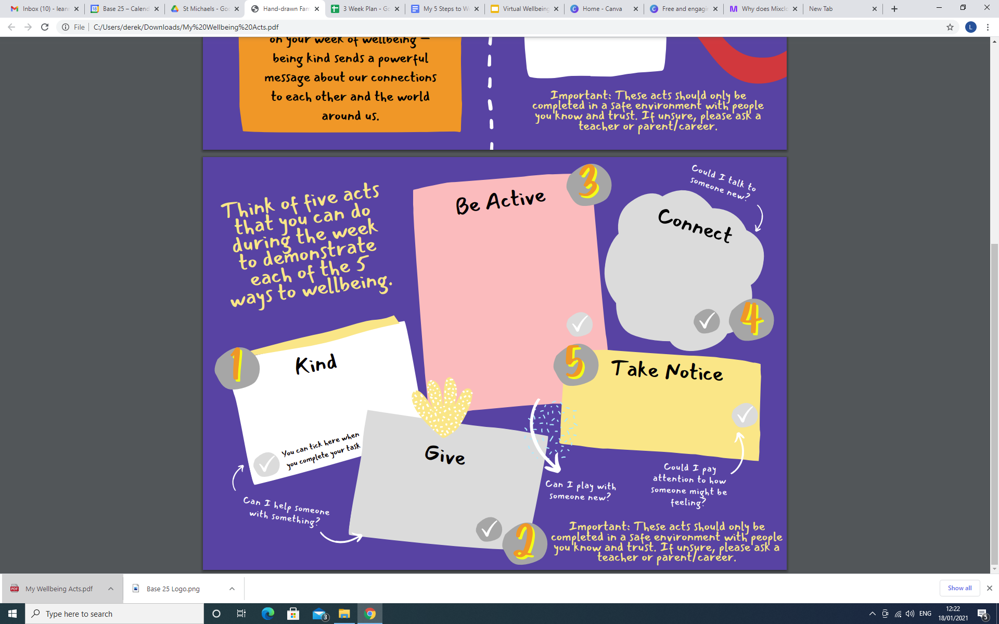
Understanding ‘My Wellbeing Acts’ Booklet

Slide 11
Week 2
Recognising Emotions / Emotion Game

Slide 12






Try and guess the emotion
you see in the picture
Emotion Game

Slide 13
What actions were you able to complete to add to your ‘My Wellbeing Acts’ Booklet?
discussion:

